Slide 1

www.espirity.com
Workbench Overview
Dwight Deugo (dwight@espirity.com)
Nesa Matic (nesa@espirity.com)
Notes:
Portions of the notes for this lecture include excerpts from the Eclipse 3.0 and 3.1 Help facility. These excerpts are made available under EPL for ease of use by instructors, (c) Copyright (c) 2000, 2005 IBM Corporation and others. For more complete information instructors are encouraged to read the full notes from the Eclipse Help facility.

Slide 2
Additional Contributors
None as of September, 2005

Slide 3
Module Overview
Workbench
Notes:
In this module, we discuss an overview of the workbench and see how customization is performed.

Slide 4
Module Road Map
Workbench
  Basics
  Resources
  Components
    Perspectives, Views and Editors
  Specialized Views
    Bookmarks, Tasks, and Search
  Customization
Notes:
In this module, we look at an overview of the workbench. This includes Workbench basics, resources, components, manipulating resources, specialized views, and customization.

Slide 5
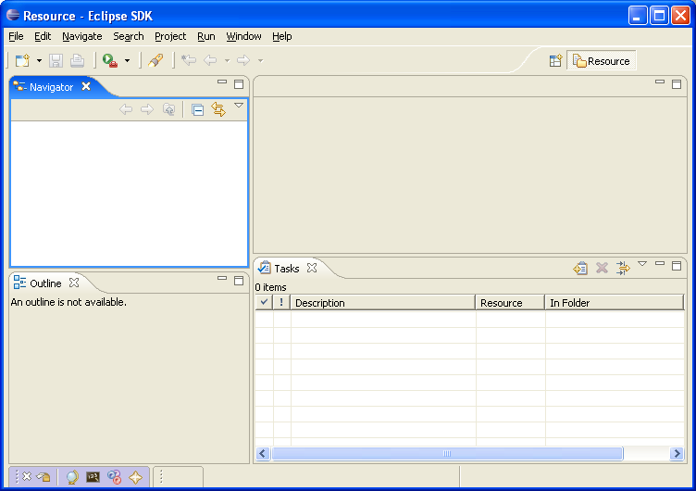
What is the Workbench?
Starting point for the development with Eclipse
  Opens up when Eclipse starts
  Represents the working environment in Eclipse
Notes:
When you start the Eclipse an instance of Workbench comes up. This is where you will be developing your Eclipse applications. Workbench contains perspectives, which contain editors and views. We will talk about Workbench components in few slides.

Slide 6
Multiple Workbench Instances
Instance of the workbench comes up when Eclipse launched
It is possible to open another instance of the Workbench
  Window → New Window
  This opens up a new Workbench window
  This is important when developing Eclipse plug-ins and you want to test them within the environment
    When testing plug-ins new instance of Workbench opens with developed plug-ins
Notes:
Multiple Workbench instances are important when working on plug-in development as they’re used for testing plug-ins within the environment. Also when you work on multiple projects it may be useful to have multiple Workbench windows open (one per project).

Slide 7
Resources in a Workbench
When working with Eclipse, you work with its resources
Resources are organized as a file/directory structure in the Workbench
  They correspond to the actual files and directories in the Workspace
  There are three different levels on resources:
    Projects
    Folders
    Files
Notes:
The Workspace is where your resources are stored. The default Eclipse workspace is under the \workspace\ directory off the Eclipse installation directory.

Slide 8
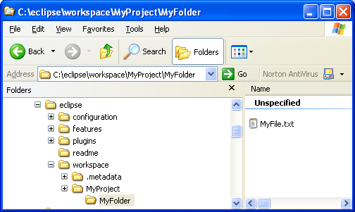
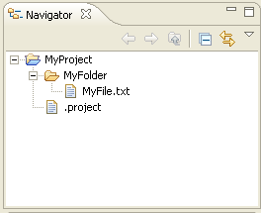
Organizing Resources
project
folder
file
Workspace
Workbench
It is possible to drag and drop resources directly between Workbench and the directory structure
Notes:
Projects are the top level of organizing resources in the Workbench. Projects contain folders and files. All of these resources correspond to the actual files in the Workspace for which is Workbench open.

Slide 9
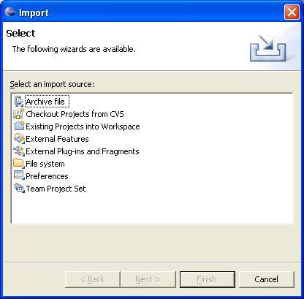
Importing Resources
Available through menu option File → Import…
Different source of resources can be imported:
  Existing projects
  Files (directory structure)
  Zip files
Notes:
Importing/Exporting feature of the Workbench is used a lot when moving work between different machines for example.

Slide 10
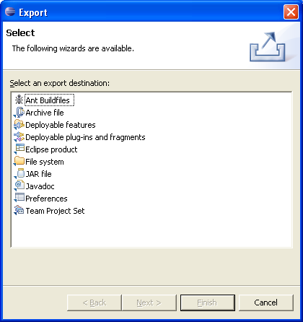
Exporting Resources
Available through menu option File → Export…
Different source of resources can be exported:
  File (directory structure)
  Zip files
  Jar files

Slide 11
Refreshing Workbench
Used for refreshing resources that change in the Workspace directly
For example, if file is added to the directory structure in the Workspace:
  Select the project
  Choose Refresh from the context menu
    This will bring the added resource into the Workbench
Notes:
In general, you should always be working with resources directly in the Workbench.

Slide 12
Resource History
Changes and saving a resource results in a new version of the resource
  All resource versions are stored in local history
  Each resource version is identified by a time stamp
  This allows you to compare different versions of the resource
There are two pop-up menu options available for accessing local history (the resource is selected):
  Compare With → Local History…
  Replace With → Local History…
  Both options bring up the same window
Notes:
Comparing local history and different versions of the resources may be important when frequently changing Java methods for example. This feature of Eclipse allows you to go back to previous versions of Java methods you change.

Slide 13
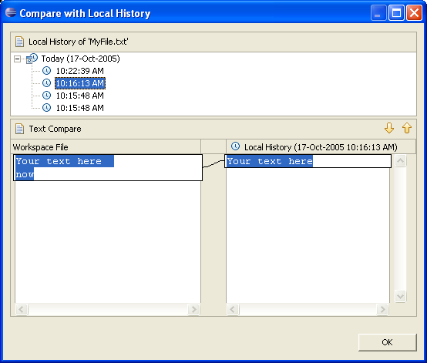
Comparing Files
Allows you to view differences between different versions
  You can move between differences
  Differences are selected

Slide 14
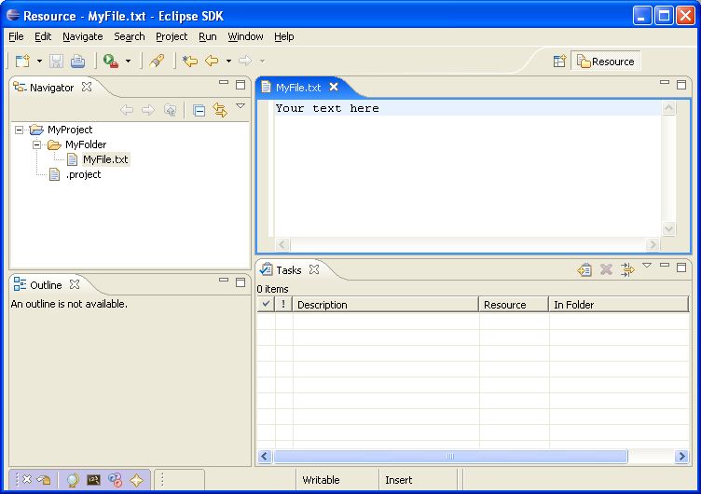
Workbench Components
Workbench contain perspectives
Perspective contain views and editors
perspective
editor
views
Notes:
Currently opened perspective is shown in the Workbench title bar. The default perspective that opens with Workbench is Resource perspective. We will talk about perspectives, views and editors in next few slides.

Slide 15
Perspectives
Perspective defines initial layout of the views in the Workbench
They are task oriented, i.e. they contain specific views for doing certain tasks:
  Java Perspective for manipulating Java code
  Resource Perspective for manipulating resources
  Debug Perspective for debugging applications
One Workbench window contains many perspectives
Notes:
Perspectives are what you will be, when developing applications, switching often between. Some perspectives open by default when an event occur. For example, if a breakpoint is encountered in the application, the Debugger perspective will open. In this perspective you can debug your code. We will talk more about debugging later in the module.

Slide 16
Opening Perspective
It is possible to open a perspective:
  In a same Workbench window
  In a new Workbench window
Perspective can be open by:
  Choosing Window → Open Perspective… menu option
  Clicking on a perspective shortcut button
Notes:
If you choose either option for opening perspective, a short list of perspectives available shows up. Full list of perspectives is shown than by choosing Other… from the proffered short list.

Slide 17
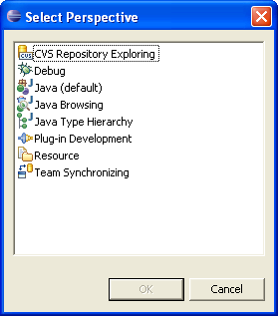
Available Perspectives
By default, the following perspectives are available in the Workbench:
Notes:
Resource perspective is used for manipulating resources.
Java, Java Browsing, and Java Browsing Hierarchy perspectives are used for manipulating Java code.
Debug perspective is used for debugging.
Plug-in development perspective is used for developing Eclipse plug-ins.
CVS Repository Explorer perspective is used for accessing CVS.

Slide 18
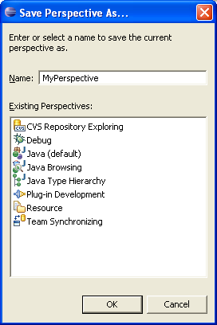
Saving Perspective
Arrangement of views and editors can be modified and saved for perspectives
  Choose Window → Save Perspective As… to save perspective
  Perspective can be saved under a new (use-defined perspectives) or an existing name
You can also reset perspective to original arrangement
  Choose Window → Reset Perspective
Notes:
Only perspectives that are default for Eclipse can be reset to original layout. Perspectives that are new cannot be reset.

Slide 19
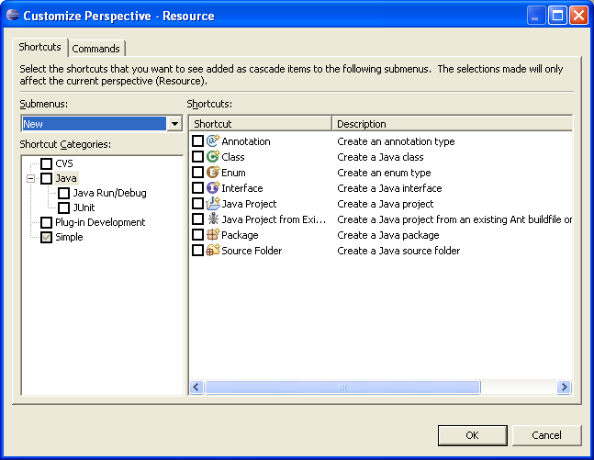
Customizing Perspectives
Available for current perspective
  Allows customization such as shortcuts, menu items and views

Slide 20
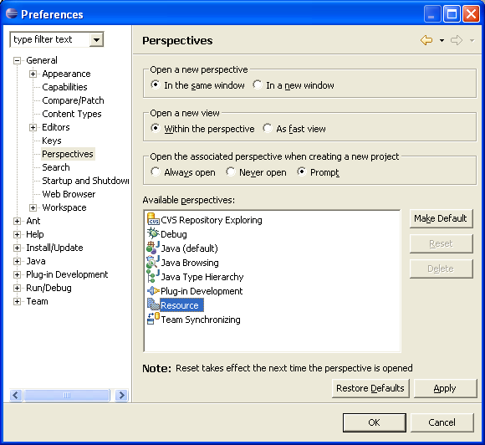
Deleting Perspectives
Only user-defined perspectives can be deleted
To delete perspective:
  Choose Window → Preferences
  Expend General category
  Select Perspectives
  Select perspective for deleting
  Click Delete
Notes:
You cannot delete predefined perspectives that come with the Eclipse.

Slide 21
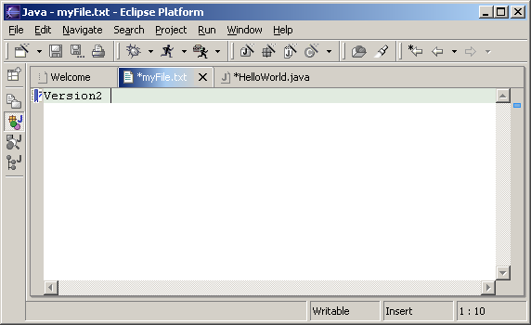
Editors
An editor for a resource opens when you double-click on a resource
  Editor type depends on a type of the resource, for example .txt files are open with the text editor
  When an editor opens on a resource, it stays open across different perspectives
    When perspectives change editor stays open
  Active editor contains menus and toolbars specific to that editor
  When you change a resource, an asterisk on the editor’s title bar indicates unsaved changes
Notes:
There is number of editors associated with particular file types in Eclipse. These are default editors, and they open automatically when you double-click on a resource in the Navigator view. You can also open an editor on a resource by choosing Open With option from the context menu on a resource in the Navigator view. This lets you choose another available editor for the selected resource type.

Slide 22
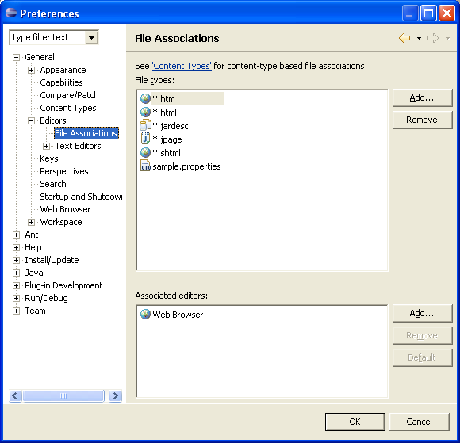
Editors and File Types
It is possible to associate an editor with a file type
  Choose Window → Preferences
  Select General
  Select Editors
  Select File Associations
  Select file type
  Click Add to associate it with an editor
Notes:
Once you associate file type with an editor that editor will appear in the list of available editors when you choose Open With from the context menu in the Navigator view.

Slide 23
Views…
The main purpose of a view is:
  To support editors
  To provide alternative presentation and navigation in the Workbench
Views can have their own menus and toolbars
  Items available in menus and toolbars are available only in that view

Slide 24
…Views
Views can:
  Appear on their own
  Appear stacked with other views
Layout of the views can be changed by clicking on the title bar and moving views
  Single views can be moved together with other views
  Stacked views can be moved to be single views

Slide 25
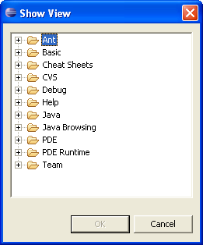
Adding Views to Perspective
To add a view to the current perspective:
  Choose Window → Show View → Other…
  The Show View window comes up
  Select window to be shown
  Click OK
Notes:
In the above example selecting Bookmark, and Tasks views will show views in the perspective.

Slide 26
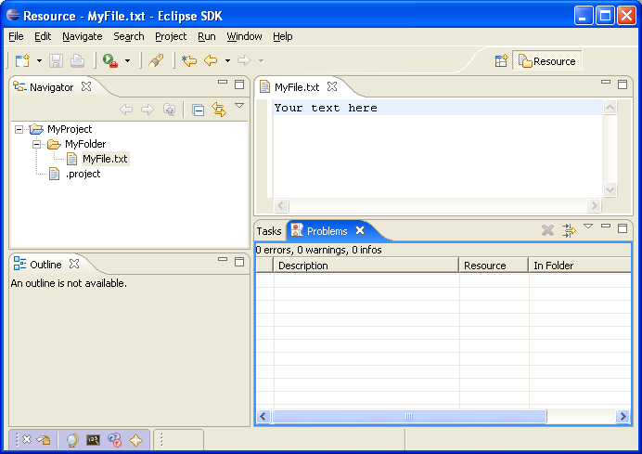
Stacked Views
Stacked views appear in a notebook form
  Each view is a notebook page

Slide 27
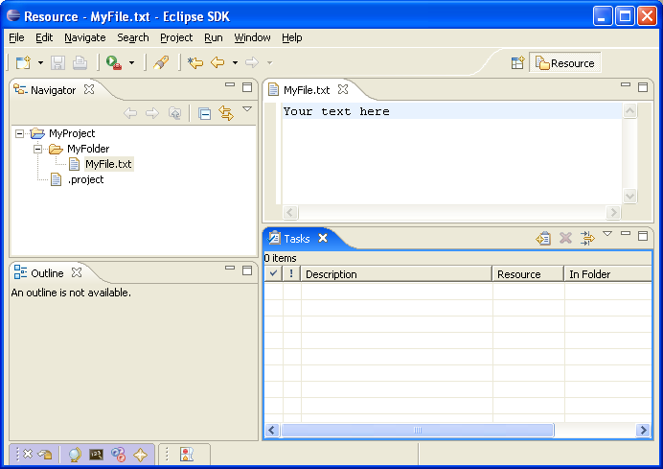
Fast Views…
Hidden views that can be quickly opened and closed
  They take up space in the Workbench
Fast views can be created by:
  Dragging an open view to the shortcut bar
  Selecting Fast View from the view’s menu
Fast View is activated by clicking on its Fast View pop-up menu option
Fast View

Slide 28
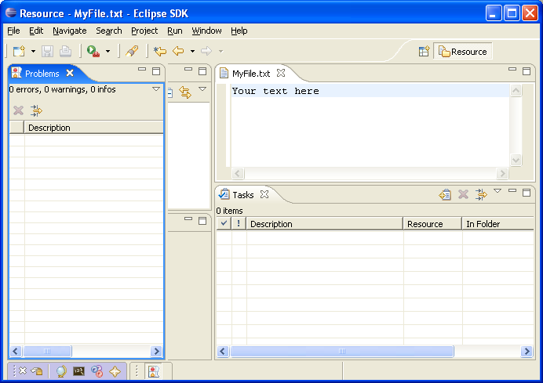
…Fast Views
Click on the Fast View opens the view in the current perspective
Click outside of the view makes it hidden again
Notes:
When you click on the Fast View that is on the shortcut toolbar, it opens in the current perspective. As soon as you click outside of the view, the view becomes hidden again.

Slide 29
Specialized Views
Some of the most commonly used views in Eclipse are:
  Navigator View
  Bookmark View
  Task View
  Search View
These views display specific information

Slide 30
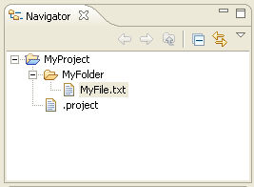
Navigator View
Used for displaying resources in the Workbench
  Provides hierarchical view of the resources
Also used for manipulating resources
  Editing
  Import/Export
  Refactoring
Notes:
Commonly used buttons in the Navigator’s view are Back and Forward buttons.
Back button displays the hierarchy that was displayed immediately prior to the current display.
Forward button displays the hierarchy that was displayed immediately after the current display.

Slide 31
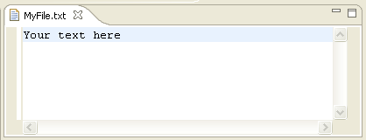
Adding Tasks
Tasks usually indicate action for the resource
  Associated with resources
    With lines in a file
  Generic
To add a task:
  Pop-up the menu on a line in the editor
  Choose Add Task…
To delete task:
  Pop-up the menu on a task
  Choose Remove Task…
Notes:
Generic tasks are created from the Tasks View.

Slide 32
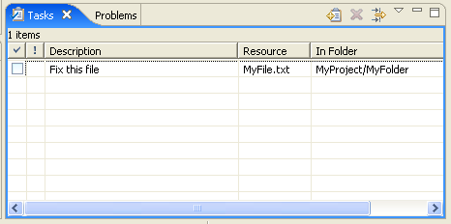
Tasks View
Displays all tasks
  Tasks associated with the resources
  Generic tasks
  Errors that occur during the development
Notes:
Tasks could be manipulated from the Tasks View. You can delete tasks, add generic tasks from the view. Double-click on the task in the Task View opens an editor on the resource the task is associated with.
Double-click on a generic task doesn’t open any editor as generic tasks are not associated with a resource.

Slide 33
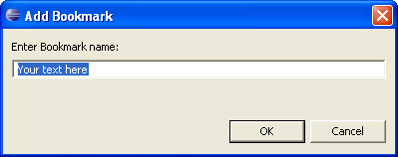
Adding Bookmarks
Bookmarks are used as markers for lines in a file
To add a bookmark:
  Pop-up menu on a line in the Editor
  Choose Add Bookmark…
  Specify bookmark name
  Click OK
Notes:
Unlike tasks that indicate specific action, bookmarks are simply markers in files or on resources, that allow you to quickly relate back to those lines in files.

Slide 34
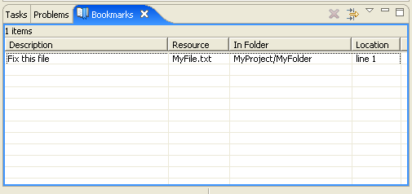
Bookmarks View
Bookmarks View displays all bookmarks available
Allows manipulation of the bookmarks:
  Double-click on a bookmark opens the editor on the resource that bookmark is associated with.
Notes:
In the bookmarks view all available bookmarks are displayed.
To delete a bookmark, select the bookmark (either on line of a file, or entire file, or in Bookmarks View) and click Delete Bookmark from the context menu.

Slide 35
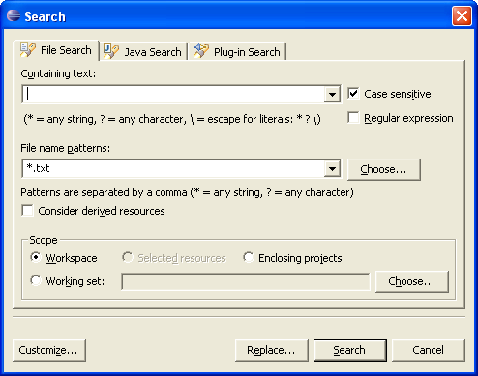
Searching
Eclipse comes with an extensive Search mechanism
  You can search for entities such as files, text, and Java classes
To start search:
  Select Search → Search… from the menu
  Choose search criteria
  Click Search
Notes:
The Search is commonly used in Eclipse and in general, Java development. Using the Eclipse search mechanism you can find Java classes, methods, implementers, references quite easily.

Slide 36
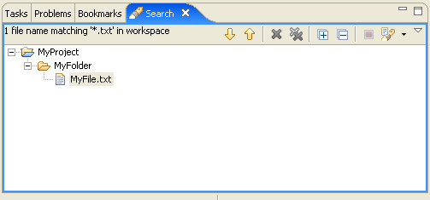
Search Results
Displayed in a Search View
Double-click on an item in a view opens an editor on that item
Search Views allows for sorting and next search

Slide 37
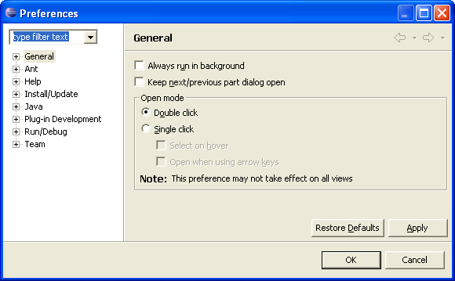
Preferences Dialog
Used for customization in the Eclipse
  For setting user preferences
  Opens by selecting Window → Preferences from the menu
Notes:
In the Preferences dialog you can set many different preferences, such as how Java code is formatted, JREs, Javadoc, and the appearance of the debugger

Slide 38
Module Summary
In this module you have seen:
  What the workbench is
  Workbench components
    Perspectives, editors and views
  Resources
  Concept and manipulation of bookmarks and tasks
  How to search in Eclipse
  Customizations of the Workbench

Slide 39

Labs!
Lab: Working with Eclipse’s Workbench (Setting up the Lab Environment)
Notes:
Now it’s time for the lab.

